Slide 1

Online Fraud Detection
.
RR
RUFINA R.F
PGDDM43

Slide 2

Introduction to Online Fraud and its Challenges
1
Types of Fraud
2
Evolving Tactics
Online fraud encompasses a wide range of deceptive activities, including credit card fraud, account takeover, and phishing scams.
Fraudsters constantly adapt their methods, employing sophisticated techniques to evade detection and exploit vulnerabilities.
3
Financial Impact
4
Reputational Damage
Online fraud poses a significant financial risk to individuals, businesses, and financial institutions, leading to substantial losses.
Fraudulent activities can damage the reputation of businesses and erode customer trust, impacting their overall success.

Slide 3
Fundamentals of Machine Learning
Supervised Learning
Unsupervised Learning
Reinforcement Learning
This approach involves training models on labeled data, where the algorithm learns to predict outcomes based on known inputs.
This method uses unlabeled data to discover patterns and relationships, enabling anomaly detection and fraud identification.
This technique focuses on training agents to learn from their interactions with an environment, optimizing decisions in real-time.

Slide 4
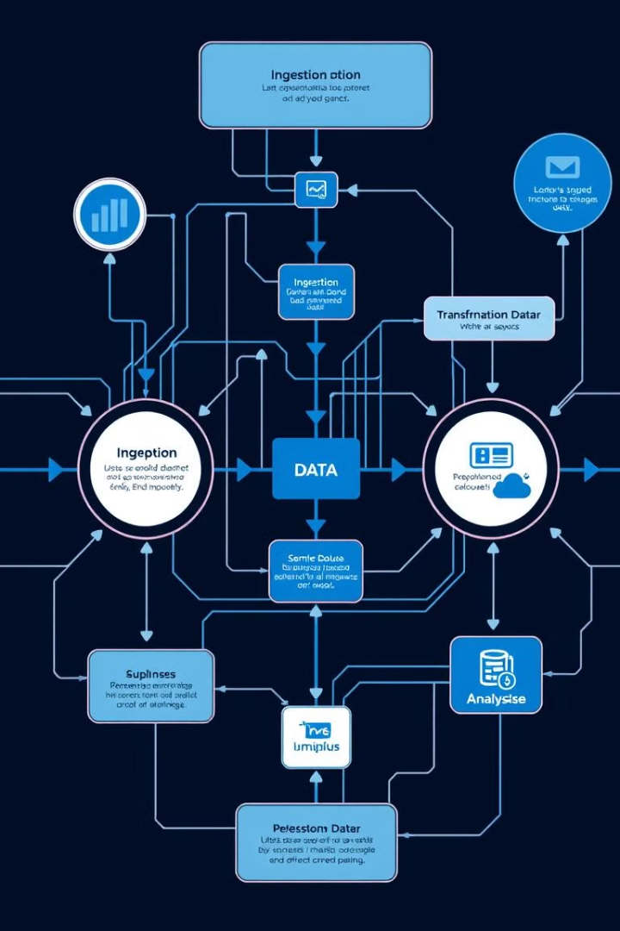
Data Collection and Preprocessing
1
Data Gathering
Collecting relevant data from various sources, including transactions, user profiles, and historical records, is essential for accurate fraud detection.
2
Data Cleaning
Removing inconsistencies, errors, and irrelevant data through techniques like outlier detection and data imputation ensures data quality.
3
Data Transformation
Converting data into a suitable format for machine learning algorithms, such as normalization and feature scaling, improves model performance.

Slide 5

Feature Engineering for Fraud Detection
Transaction Features
User Profile Features
These features, such as transaction amount, time, and location, provide insights into the characteristics of fraudulent transactions.
User information, including demographics, purchase history, and device usage patterns, can help identify unusual activity.
Behavioral Features
Features capturing user actions, such as login attempts, password changes, and browsing patterns, can reveal suspicious behaviors.

Slide 6

Model Selection and Training
Decision Trees
Support Vector Machines (SVMs)
Neural Networks
Rule-based models
Linear models
Ensemble methods

Slide 7





Evaluation Metrics and Model Performance
Accuracy
Precision
Recall
F1-Score
Measures the overall correctness of the model's predictions.
Indicates the proportion of correctly identified fraudulent transactions.
Reflects the model's ability to detect all fraudulent transactions.
Provides a balanced measure of precision and recall.

Slide 8




Deployment and Monitoring
Cloud Deployment
Deploying fraud detection models in the cloud ensures scalability and flexibility to handle growing data volumes.
Real-Time Monitoring
Continuously monitoring model performance and identifying potential issues is crucial for maintaining effectiveness.
Model Retraining
Regularly retraining models on new data ensures they adapt to evolving fraud patterns and maintain accuracy.

Slide 9

Conclusion
Machine learning plays a vital role in online fraud detection, empowering businesses and institutions to proactively identify and mitigate this evolving threat.

